Slide 1

Mini-batch SGD
Loop:
Sample a batch of data
Forward prop it through the graph, get loss
Backprop to calculate the gradients
Update the parameters using the gradient

Slide 2
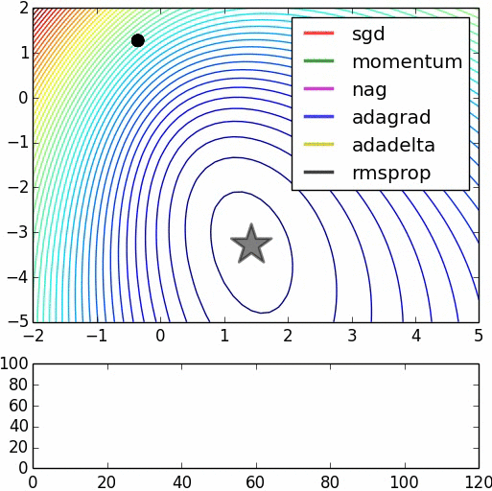
Parameter updates
We covered:
sgd,
momentum,
nag,
adagrad,
rmsprop,
adam (not in this vis),
we did not cover adadelta
Image credits: Alec Radford

Slide 3
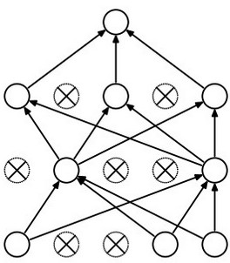
Dropout
Forces the network to have a redundant representation.
has an ear
X
has a tail
is furry
X
cat
score
has claws
X
mischievous
look

Slide 4

Convolutional Neural Networks
[LeNet-5, LeCun 1980]

Slide 5
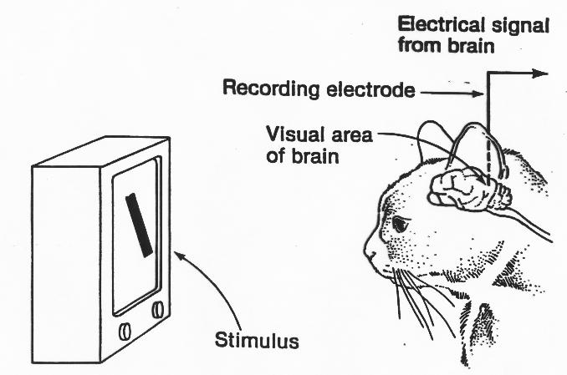
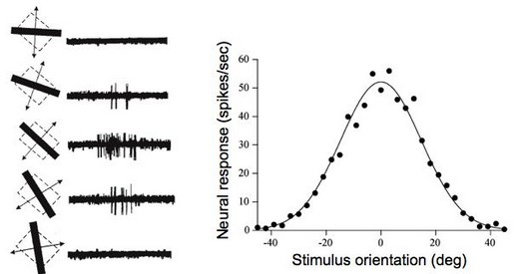
A bit of history:
Hubel & Wiesel,
1959
RECEPTIVE FIELDS OF SINGLE NEURONES IN
THE CAT'S STRIATE CORTEX
1962
RECEPTIVE FIELDS, BINOCULAR INTERACTION
AND FUNCTIONAL ARCHITECTURE IN
THE CAT'S VISUAL CORTEX
1968...

Slide 6
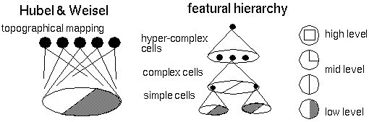
Hierarchical organization

Slide 7
Convolutional Neural Networks
(First without the brain stuff)

Slide 8
Convolution Layer
32x32x3 image
32
height
32
width
3
depth

Slide 9
Convolution Layer
32x32x3 image
5x5x3 filter
32
Convolve the filter with the image
i.e. “slide over the image spatially, computing dot products”
32
3

Slide 10
Convolution Layer
Filters always extend the full depth of the input volume
32x32x3 image
5x5x3 filter
32
Convolve the filter with the image
i.e. “slide over the image spatially, computing dot products”
32
3

Slide 11

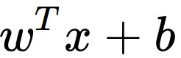
Convolution Layer
32x32x3 image
5x5x3 filter
32
1 number:
the result of taking a dot product between the filter and a small 5x5x3 chunk of the image
(i.e. 5*5*3 = 75-dimensional dot product + bias)
32
3

Slide 12
Convolution Layer
activation map
32x32x3 image
5x5x3 filter
32
28
convolve (slide) over all spatial locations
32
28
3
1

Slide 13
consider a second, green filter
Convolution Layer
32x32x3 image
5x5x3 filter
activation maps
32
28
convolve (slide) over all spatial locations
32
28
3
1

Slide 14
For example, if we had 6 5x5 filters, we’ll get 6 separate activation maps:
activation maps
32
28
Convolution Layer
32
28
3
6
We stack these up to get a “new image” of size 28x28x6!

Slide 15
Preview: ConvNet is a sequence of Convolution Layers, interspersed with activation functions
32
28
CONV,
ReLU
e.g. 6 5x5x3 filters
32
28
3
6

Slide 16
Preview: ConvNet is a sequence of Convolutional Layers, interspersed with activation functions
32
28
24
….
CONV,
ReLU
e.g. 6 5x5x3 filters
CONV,
ReLU
e.g. 10 5x5x6 filters
CONV,
ReLU
32
28
24
3
6
10

Slide 17

Preview
[From recent Yann LeCun slides]

Slide 18
Preview
[From recent Yann LeCun slides]

Slide 19
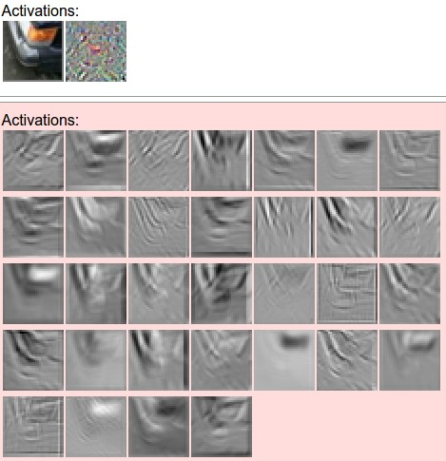
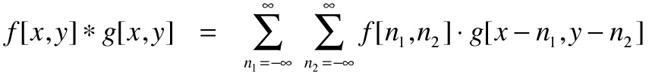
one filter =>
one activation map
example 5x5 filters
(32 total)
We call the layer convolutional because it is related to convolution of two signals:
elementwise multiplication and sum of a filter and the signal (image)

Slide 20

preview:

Slide 21
A closer look at spatial dimensions:
activation map
32x32x3 image
5x5x3 filter
32
28
convolve (slide) over all spatial locations
32
28
3
1

Slide 22
A closer look at spatial dimensions:
7
7x7 input (spatially)
assume 3x3 filter
7

Slide 23
A closer look at spatial dimensions:
7
7x7 input (spatially)
assume 3x3 filter
7

Slide 24
A closer look at spatial dimensions:
7
7x7 input (spatially)
assume 3x3 filter
7

Slide 25
A closer look at spatial dimensions:
7
7x7 input (spatially)
assume 3x3 filter
7

Slide 26
A closer look at spatial dimensions:
7
7x7 input (spatially)
assume 3x3 filter
=> 5x5 output
7

Slide 27
A closer look at spatial dimensions:
7
7x7 input (spatially)
assume 3x3 filter
applied with stride 2
7

Slide 28
A closer look at spatial dimensions:
7
7x7 input (spatially)
assume 3x3 filter
applied with stride 2
7

Slide 29
A closer look at spatial dimensions:
7
7x7 input (spatially)
assume 3x3 filter
applied with stride 2
=> 3x3 output!
7

Slide 30
A closer look at spatial dimensions:
7
7x7 input (spatially)
assume 3x3 filter
applied with stride 3?
7

Slide 31
A closer look at spatial dimensions:
7
7x7 input (spatially)
assume 3x3 filter
applied with stride 3?
7
doesn’t fit!
cannot apply 3x3 filter on 7x7 input with stride 3.

Slide 32
N
Output size:
(N - F) / stride + 1
e.g. N = 7, F = 3:
stride 1 => (7 - 3)/1 + 1 = 5
stride 2 => (7 - 3)/2 + 1 = 3
stride 3 => (7 - 3)/3 + 1 = 2.33 :\
F
N
F

Slide 33
In practice: Common to zero pad the border
0 | 0 | 0 | 0 | 0 | 0
0
0
0
0
e.g. input 7x7
3x3 filter, applied with stride 1
pad with 1 pixel border => what is the output?
(recall:)
(N - F) / stride + 1

Slide 34
In practice: Common to zero pad the border
0 | 0 | 0 | 0 | 0 | 0
0
0
0
0
e.g. input 7x7
3x3 filter, applied with stride 1
pad with 1 pixel border => what is the output?
7x7 output!

Slide 35
In practice: Common to zero pad the border
0 | 0 | 0 | 0 | 0 | 0
0
0
0
0
e.g. input 7x7
3x3 filter, applied with stride 1
pad with 1 pixel border => what is the output?
7x7 output!
in general, common to see CONV layers with stride 1, filters of size FxF, and zero-padding with (F-1)/2. (will preserve size spatially)
e.g. F = 3 => zero pad with 1
F = 5 => zero pad with 2
F = 7 => zero pad with 3

Slide 36
Remember back to…
E.g. 32x32 input convolved repeatedly with 5x5 filters shrinks volumes spatially!
(32 -> 28 -> 24 ...). Shrinking too fast is not good, doesn’t work well.
32
28
24
….
CONV,
ReLU
e.g. 6 5x5x3 filters
CONV,
ReLU
e.g. 10 5x5x6 filters
CONV,
ReLU
32
28
24
3
6
10

Slide 37
Examples time:
Input volume: 32x32x3
10 5x5 filters with stride 1, pad 2
Output volume size: ?

Slide 38
Examples time:
Input volume: 32x32x3
10 5x5 filters with stride 1, pad 2
Output volume size:
(32+2*2-5)/1+1 = 32 spatially, so
32x32x10

Slide 39
Examples time:
Input volume: 32x32x3
10 5x5 filters with stride 1, pad 2
Number of parameters in this layer?

Slide 40
Examples time:
Input volume: 32x32x3
10 5x5 filters with stride 1, pad 2
Number of parameters in this layer?
each filter has 5*5*3 + 1 = 76 params (+1 for bias)
=> 76*10 = 760

Slide 41
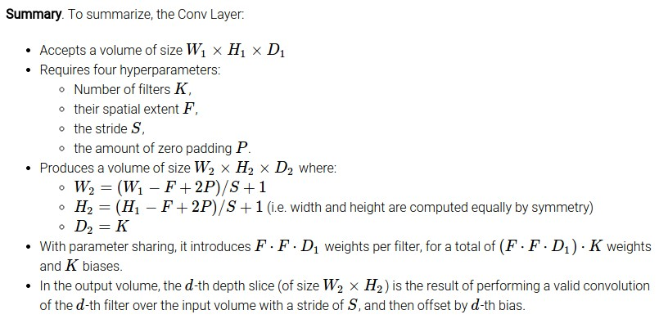

Slide 42
Common settings:
K = (powers of 2, e.g. 32, 64, 128, 512)
F = 3, S = 1, P = 1
F = 5, S = 1, P = 2
F = 5, S = 2, P = ? (whatever fits)
F = 1, S = 1, P = 0

Slide 43
(btw, 1x1 convolution layers make perfect sense)
1x1 CONV
with 32 filters
56
56
(each filter has size 1x1x64, and performs a 64-dimensional dot product)
56
56
64
32

Slide 44
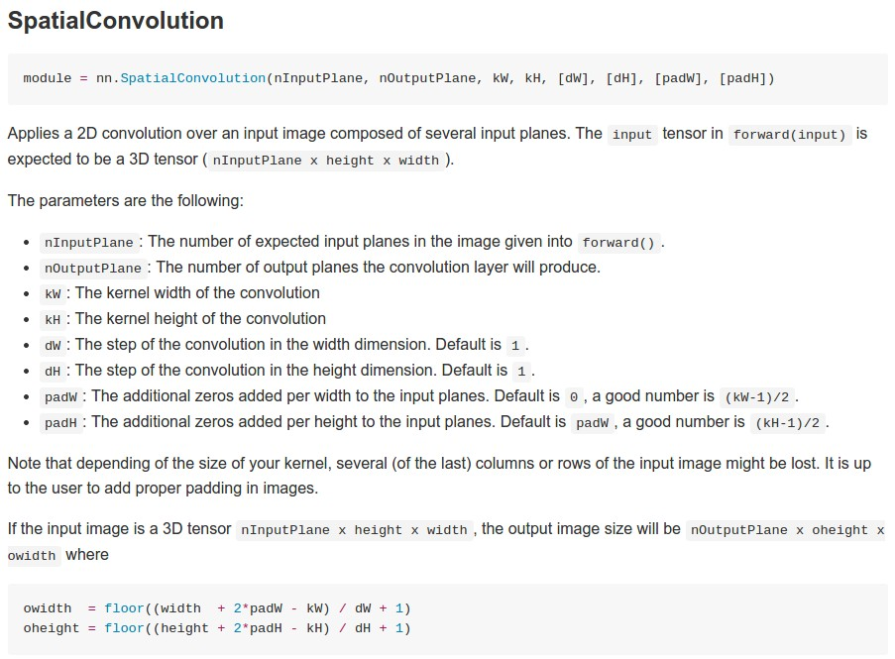
Example: CONV layer in Torch

Slide 45
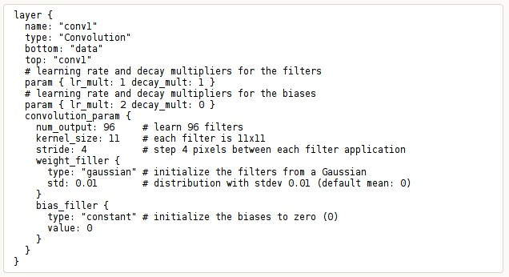
Example: CONV layer in Caffe

Slide 46
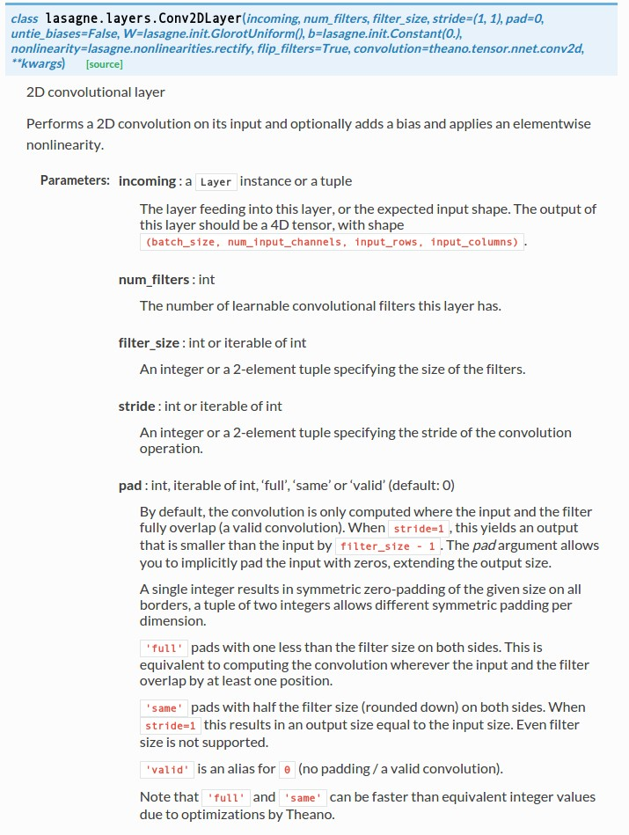
Example: CONV layer in Lasagne

Slide 47
The brain/neuron view of CONV Layer
32x32x3 image
5x5x3 filter
32
1 number:
the result of taking a dot product between the filter and this part of the image
(i.e. 5*5*3 = 75-dimensional dot product)
32
3

Slide 48

The brain/neuron view of CONV Layer
32x32x3 image
5x5x3 filter
32
It’s just a neuron with local connectivity...
1 number:
the result of taking a dot product between the filter and this part of the image
(i.e. 5*5*3 = 75-dimensional dot product)
32
3

Slide 49
The brain/neuron view of CONV Layer
32
28
An activation map is a 28x28 sheet of neuron outputs:
Each is connected to a small region in the input
All of them share parameters
“5x5 filter” -> “5x5 receptive field for each neuron”
32
28
3

Slide 50
The brain/neuron view of CONV Layer
32
E.g. with 5 filters,
CONV layer consists of neurons arranged in a 3D grid
(28x28x5)
There will be 5 different neurons all looking at the same region in the input volume
28
32
28
3
5

Slide 51
two more layers to go: POOL/FC

Slide 52

Pooling layer
makes the representations smaller and more manageable
operates over each activation map independently:

Slide 53
MAX POOLING
Single depth slice
1 | 1 | 2 | 4
5 | 6 | 7 | 8
3 | 2 | 1 | 0
1 | 2 | 3 | 4
x
max pool with 2x2 filters and stride 2
6 | 8
3 | 4
y

Slide 54
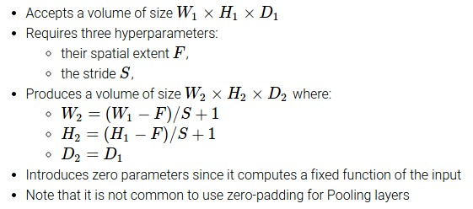

Slide 55
Common settings:
F = 2, S = 2
F = 3, S = 2

Slide 56
Fully Connected Layer (FC layer)
Contains neurons that connect to the entire input volume, as in ordinary Neural Networks

Slide 57
[ConvNetJS demo: training on CIFAR-10]
http://cs.stanford.edu/people/karpathy/convnetjs/demo/cifar10.html

Slide 58
Case Study: LeNet-5
[LeCun et al., 1998]
Conv filters were 5x5, applied at stride 1
Subsampling (Pooling) layers were 2x2 applied at stride 2
i.e. architecture is [CONV-POOL-CONV-POOL-CONV-FC]

Slide 59
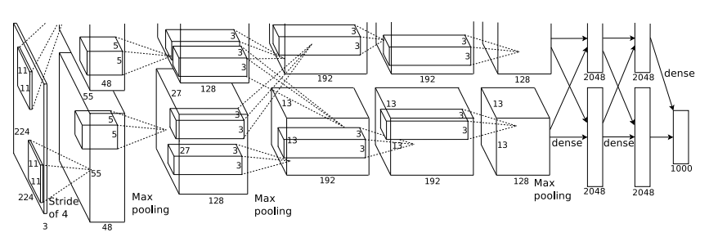
Case Study: AlexNet
[Krizhevsky et al. 2012]
Input: 227x227x3 images
First layer (CONV1): 96 11x11 filters applied at stride 4
=>
Q: what is the output volume size? Hint: (227-11)/4+1 = 55

Slide 60
Case Study: AlexNet
[Krizhevsky et al. 2012]
Input: 227x227x3 images
First layer (CONV1): 96 11x11 filters applied at stride 4
=>
Output volume [55x55x96]
Q: What is the total number of parameters in this layer?

Slide 61
Case Study: AlexNet
[Krizhevsky et al. 2012]
Input: 227x227x3 images
First layer (CONV1): 96 11x11 filters applied at stride 4
=>
Output volume [55x55x96]
Parameters: (11*11*3)*96 = 35K

Slide 62
Case Study: AlexNet
[Krizhevsky et al. 2012]
Input: 227x227x3 images
After CONV1: 55x55x96
Second layer (POOL1): 3x3 filters applied at stride 2
Q: what is the output volume size? Hint: (55-3)/2+1 = 27

Slide 63
Case Study: AlexNet
[Krizhevsky et al. 2012]
Input: 227x227x3 images
After CONV1: 55x55x96
Second layer (POOL1): 3x3 filters applied at stride 2
Output volume: 27x27x96
Q: what is the number of parameters in this layer?

Slide 64
Case Study: AlexNet
[Krizhevsky et al. 2012]
Input: 227x227x3 images
After CONV1: 55x55x96
Second layer (POOL1): 3x3 filters applied at stride 2
Output volume: 27x27x96
Parameters: 0!

Slide 65
Case Study: AlexNet
[Krizhevsky et al. 2012]
Input: 227x227x3 images
After CONV1: 55x55x96
After POOL1: 27x27x96
...

Slide 66
Case Study: AlexNet
[Krizhevsky et al. 2012]
Full (simplified) AlexNet architecture:
[227x227x3] INPUT
[55x55x96] CONV1: 96 11x11 filters at stride 4, pad 0
[27x27x96] MAX POOL1: 3x3 filters at stride 2
[27x27x96] NORM1: Normalization layer
[27x27x256] CONV2: 256 5x5 filters at stride 1, pad 2
[13x13x256] MAX POOL2: 3x3 filters at stride 2
[13x13x256] NORM2: Normalization layer
[13x13x384] CONV3: 384 3x3 filters at stride 1, pad 1
[13x13x384] CONV4: 384 3x3 filters at stride 1, pad 1
[13x13x256] CONV5: 256 3x3 filters at stride 1, pad 1
[6x6x256] MAX POOL3: 3x3 filters at stride 2
[4096] FC6: 4096 neurons
[4096] FC7: 4096 neurons
[1000] FC8: 1000 neurons (class scores)
Details/Retrospectives:
- first use of ReLU
- used Norm layers (not common anymore)
- heavy data augmentation
- dropout 0.5
- batch size 128
- SGD Momentum 0.9
- Learning rate 1e-2, reduced by 10
manually when val accuracy plateaus
- L2 weight decay 5e-4
- 7 CNN ensemble: 18.2% -> 15.4%

Slide 67
Case Study: AlexNet
[Krizhevsky et al. 2012]
Full (simplified) AlexNet architecture:
[227x227x3] INPUT
[55x55x96] CONV1: 96 11x11 filters at stride 4, pad 0
[27x27x96] MAX POOL1: 3x3 filters at stride 2
[27x27x96] NORM1: Normalization layer
[27x27x256] CONV2: 256 5x5 filters at stride 1, pad 2
[13x13x256] MAX POOL2: 3x3 filters at stride 2
[13x13x256] NORM2: Normalization layer
[13x13x384] CONV3: 384 3x3 filters at stride 1, pad 1
[13x13x384] CONV4: 384 3x3 filters at stride 1, pad 1
[13x13x256] CONV5: 256 3x3 filters at stride 1, pad 1
[6x6x256] MAX POOL3: 3x3 filters at stride 2
[4096] FC6: 4096 neurons
[4096] FC7: 4096 neurons
[1000] FC8: 1000 neurons (class scores)

